Slide 1
Summary of PRAGMA Steering Committee Meeting
2014 April 11

Slide 2
A View on Taiwan
Taiwan “is a home where time accelerates and people cram three days of living into every twenty-four hours”
Notes:
Shelley Rigger,

Slide 3
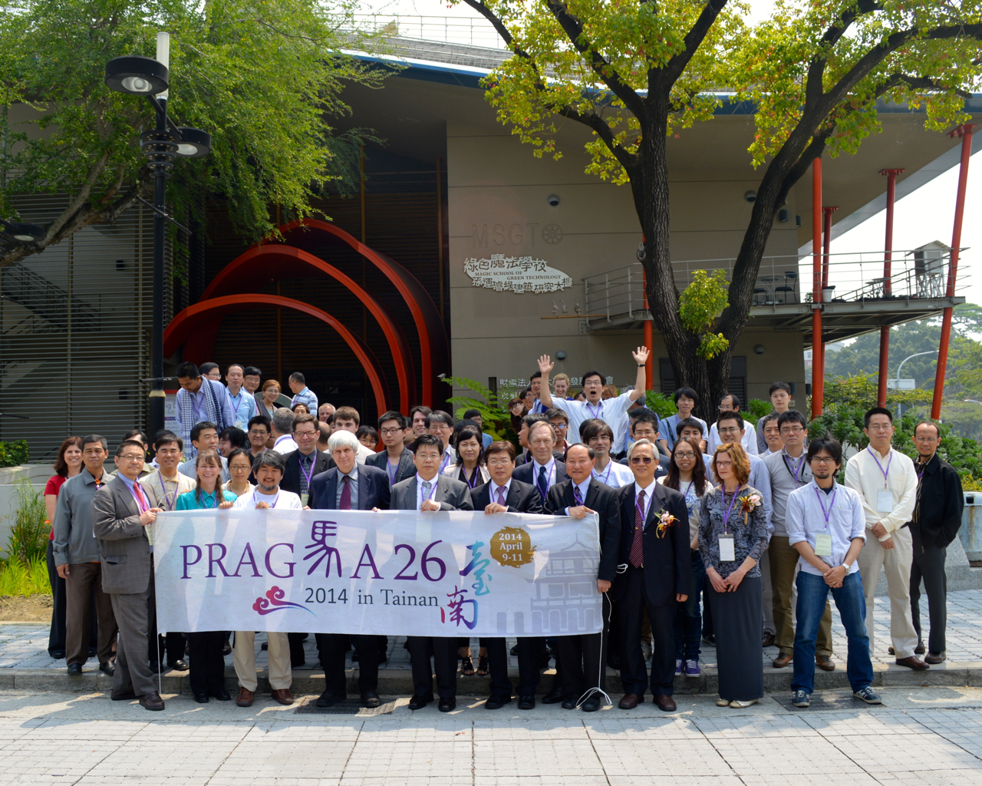

Slide 4
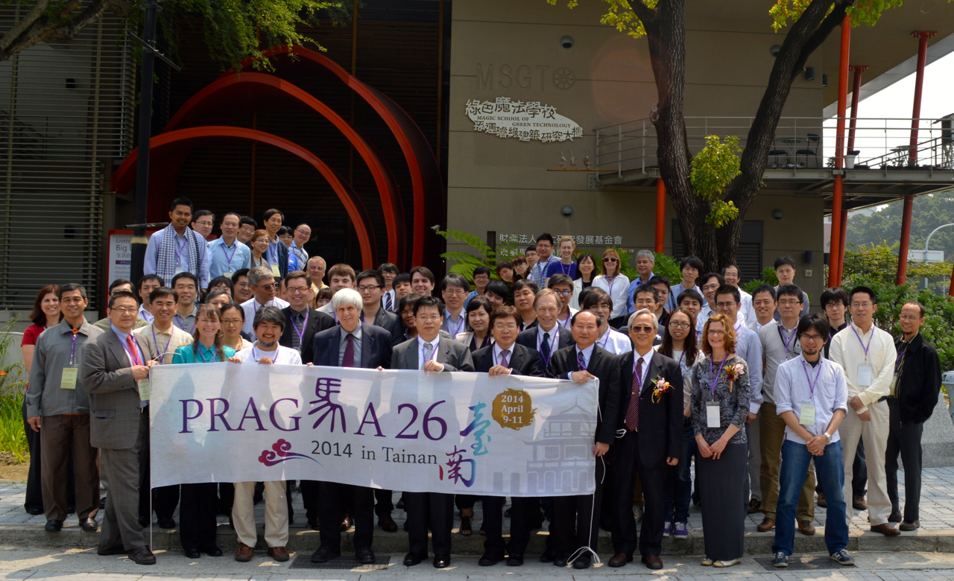
PRAGMA 26

Slide 5
Comments on PRAGMA
Seeks to promote
Initiative
Openness
Sharing (ideas, software)
Experimentation
At this meeting: Encourage broader discussions among participants
Expeditions: Integration across technologies
Engagement of participants
Projects conceived by small group say small; projects conceived broadly may stay broad
PRAGMA’s composition
Impact / outcome driven organizations
Research driven organizations
Don’t jump to conclusions
Notes:
Do not jump to conclusion

Slide 6
Two Other Ideas
Sensors at every site
Create an all PRAGMA project
Biosciences
Invite leadership

Slide 7
Shonan Meeting
Water Disaster Management and Big Data
July 7 – 10
Opportunity to think deeply about issue
Possible outcome:
Address important issue
Lead to PRAGMA activity
Looking for interested participants
Talk with Fang-Pang Lin
NEEDS YOUR INPUT BEFORE TUESDAY, April 15

Slide 8
Broadening Leadership
Looked to identify individuals who might be interested in co-leading working groups or new expeditions
Steering Committee Composition and Evolution
Discussed options to position Steering Committee with new input
Ideas to be discussed over summer
Ex-officio
Adding Students
Adopt GLEON model for identifying new members

Slide 9
Important Notice
Send slides to Nadya Williams or Karen Chang
nadya@sdsc.edu
d00ycc00@nchc.narl.org.tw

Slide 10
Thank You
Program Committee
Beth Plale (Indian U & PRAGMA 27 chair)
Chao-Chin Lin (TFRI
Heru Suhartanto (UI ndonesia,
JingYuan Luke (MIMOS)
José Fortes (U Florida)
Ichigawa Kohei (NAIST)
Meilan Jiang (Konkuk U)
Philip Papadopoulos (UCSD)
Ruth Lee (KISTI)
Wei-Cheng Huang (NCHC)
Demo Chair
Shumi Huang (NCHC)
Poster Chair
Quan Zhou (Indiana U)
Meilan Jiang (Konkuk U)
Yuan Luo (Indiana U)
Local Organization
Yu-Chun (Karen Chang)
Shu-Shin (Tail) Liu
Anson Wong
Su-Fang Chen
Shiau-Pei (Peggy) Tsai
Several Students
Chair
- Ce-Kuen Shieh
- Fang-Pang Lin

Slide 11
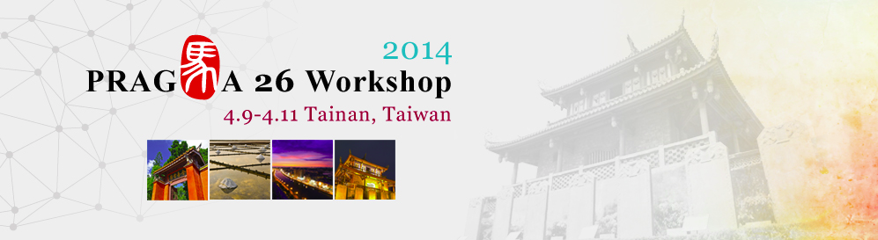
Thank You
All Participants

